Slide 1
Family-School Partnerships
Second District PTA
Officer Training
June 2023
Notes:
I’m going to spend the next 30 minutes telling you about the PTA’s research-based standards for family-school partnerships and how they might help your school.

Slide 2
PTA’s National Standards for Family-School Partnerships set the bar more than 20 years ago for how schools and parent organizations should work together to support student success
Notes:
Did you know that the PTA was part of the working group a several years ago that created the Family Engagement Standards for SFUSD? These standards are largely based on the standards developed by the National PTA more than 20 years ago, but are tailored for our district.
The National PTA began updating the standards 2 years ago to:
Incorporate research and best practices since 2008 (the last time they did an update)
Integrate the perspectives of families, educators, and youth, particularly those from historically marginalized communities
Improve the usefulness of the Standards across the education system
Here we are! Lots of resources to support this that you could explore with your school community at pta.org/standards
The overview is here: https://www.pta.org/docs/default-source/files/runyourpta/2022/national-standards/standards-overview.pdf

Slide 3
Research shows…
Research shows that family engagement matters for student success. Students whose families are engaged are more likely to:
Attend school
Avoid discipline problems
Achieve at higher levels
Graduate
Research also suggests that family engagement is equally as important as school leadership or a rigorous curriculum to predict school improvement.
But, how to engage together in ways that reach all families and have a positive impact on student success?

Slide 4
A partnership project
Vision setting with school leaders and staff
Why are we prioritizing family-school partnerships?
How does this connect to our values?
What’s exciting about this priority?
What opportunities does it create?
What does success look like?
What do you believe is possible?
What commitments need to be made?
Goals for family-school partnerships
What’s most important?
What will be different?
Not something the PTA can take on alone.
Notes:
Using these standards to guide work at your school must be a partnership effort. A PTA cannot do this on their own, though they could be strong advocate to help move it along.
You’ll want to encourage leadership at your school to do some vision setting. Here are some of the questions school leadership and staff can consider, along with families. They will need to be invested in doing the work.

Slide 5
How we’ll move through each standard
Introduce the standard
Describe the two goals for that standard, along with key indicators that you’re on the right track to meet those goals
Zoom into one indicator for each standard and explore what things might be done to excel in that particular area
Notes:
There are 6 standards. This could easily be overwhelming! That’s why we’ll zoom in on tiny pieces. And you can review this deck and all the resources at your convenience, when you’re ready.
Here’s how we’ll move through each standard…

Slide 6
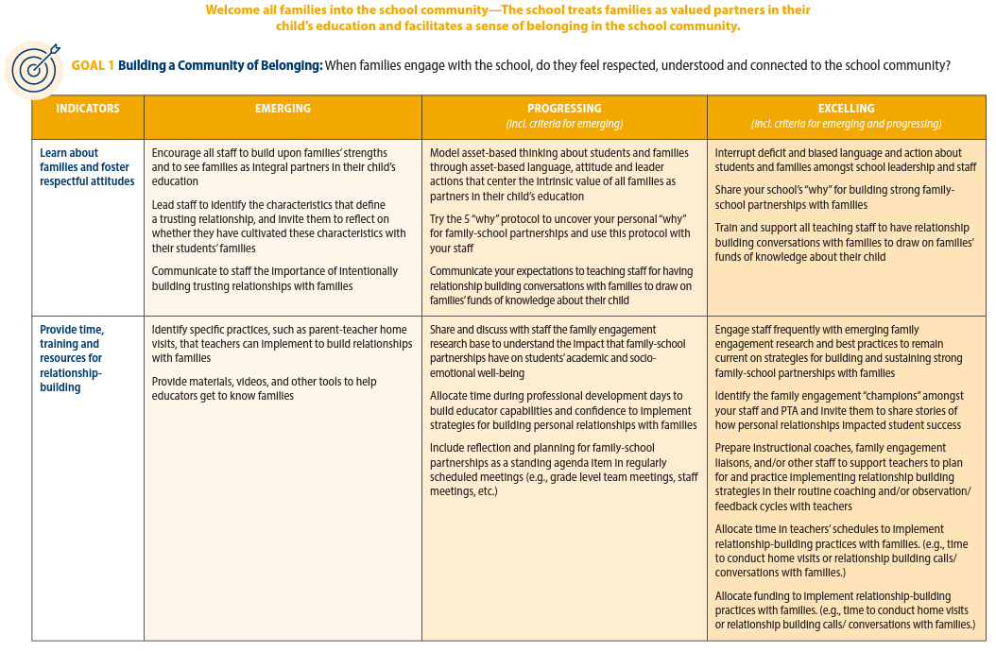
The rubric assessment tool
Notes:
Before we start going through the standards, I want to show you this tool. The PTA’s Center for Family Engagement created a rubric assessment tool that charts every indicator within every goal within every standard to help your school see how it’s doing.
You’ll see the indicator on the left column and then each column after that progresses from early stages of progress toward doing pretty well, listing criteria to help you know where your school falls. Those stages are called:
Emerging
Progressing (which includes the criteria for emerging)
Excelling (which includes the criteria for progressing)
You can refer to this if you decide to use this at your school. But it’s too overwhelming of a document to be super useful to use in detail throughout this session today.
Here is the rubric: https://www.pta.org/docs/default-source/files/runyourpta/2022/national-standards/npta-leader-rubric.pdf

Slide 7
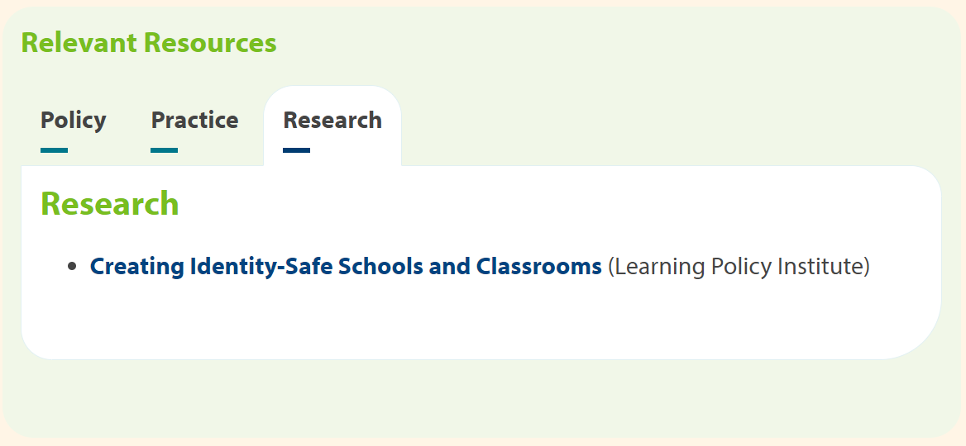
Relevant resources
Notes:
If you go to the PTA website I just mentioned (pta.org/standards) and scroll down all the way down the page, you’ll see you can click on each standard to find a lot of what we’ll talk about today, plus many more resources. Here is what you would find for the first standard. We won’t go over these in this session, but I want you to know what you can find there.

Slide 8
Now, set ONE goal
Notes:
While you’re hearing what I share, think about this.
Work with the principal and other staff at your school to set just ONE GOAL this year. Don’t try to do everything, everywhere, all at once. :)
As we go through the standards, jot down a couple areas that resonate with you, so you can bring some initial thoughts up with your school community when you come back to school next fall.

Slide 9
Standard 1 Welcome All Families
Goal 1: Build a Community of Belonging: When families engage with the school and PTA, do they feel respected, understood and connected to the school community?
School and PTA indicators:
Learn about families and foster respectful attitudes
Provide time, training, and resources for relationship-building
Facilitate opportunities for restorations and connection, especially with historically marginalized families and students
Use cultural and linguistically responsive engagement practices
Invite families to contribute to the school community
Notes:
Standard 1: Welcome All Families
The school treats families as valued partners in their child’s education and facilitates a sense of belonging in the school community.
Walk through the goal and indicators

Slide 10
Standard 1 Welcome All Families
Goal 2: Create an Inclusive Environment: Do the school’s and PTA’s efforts encourage engagement with and among the diversity of families in the community?
School and PTA indicators:
Encourage school staff to see engaging all families as part of their responsibilities
Create an accessible, family-friendly campus and/or virtual school
Track family engagement data and regularly examine it to identify gaps in access
Learn about and remove barriers for families to participate fully

Slide 11
Standard 1 Welcome All Families - Goal 1 example
Possible actions:
Hold a workshop about asset-based thinking (vs deficit-based thinking) for families and staff
Use a PTA or SSC meeting to have groups of people brainstorm lists of the reasons why strong partnerships with families are good for students and the school. Post the answers in a place where all can see them.
Notes:
Here is an indicator within Goal 1 of the the first standard: Welcome all Families.
Walk through a few of the emerging, progressing, and excelling examples
Walk through the possible action you could take, if this was the indicator you selected to focus on this year.

Slide 12
Standard 1 Things you can do
Work with the school and PTA to train staff and leaders to hold relationship-building conversations with families
Collaborate with your school to conduct listening sessions to learn how to help families feel respected, understood and connected to the school and PTA
Ensure that your PTA and school are tracking input and participation by key demographics, so you know who has or has not been included
Create opportunities for families to contribute based on their time, skills and passions
Advocate for your school to make sure that front office staff, educators, administrators, and all others are using best practices in family engagement
Ensure that opportunities for families to participate in the PTA are differentiated for families who are not available during typical school hours
Ask the school to allocate time and resources to audit family engagement practices around cultural responsiveness
Notes:
I’m mostly going to skip these slides about Things You Can Do, to not completely overwhelm you. You can refer to these at your leisure later.

Slide 13
Standard 2 Communicate Effectively
Goal 1: Exchange Information Between School and Families: Are families able to receive and share information in culturally and linguistically sustaining ways?
School and PTA Indicators:
Learn about and meet families’ communication preferences
Address access by providing interpretation, translation, and/or accommodations
Coordinate information-sharing across communication outlets
Gather family input and report back with how input was used
Foster transparency and enable families to follow-up
Co-create engagement plans for times of crisis
Notes:
Standard 2: Communicate Effectively.
The school supports staff to engage in proactive, timely, and two-way communication so that all families can easily understand and contribute to their child’s educational experience.
Walk through the goal and indicators

Slide 14
Standard 2 Communicate Effectively
Goal 2: Facilitate Parent-Teacher Communication: Does the school and PTA promote communication between families and teachers?
School and PTA Indicators:
Co-develop communication expectations with families and staff
Provide time, training and resources for parent-teacher communication
Solicit teacher and family feedback on how communication is going and what could be improved

Slide 15
Standard 2 Communicate Effectively
Possible actions:
Work in partnership with the School Site Council, ELAC and/or other affinity groups to host a community meeting to ask for their input on a few specific areas, or what their priorities are for their child. Also send surveys for those who can’t attend.
Convene parents, staff, and students to review the results and make recommendations to the SSC, PTA, ELAC, etc. for incorporation into your SPSA (School Plan for Student Achievement) and elsewhere it’s appropriate.
Once plans are made, share back with families what happened as a result of their input, and invite them to continue sharing.
Notes:
Here is an indicator within Goal 1 of the the second standard: Communicate Effectively.
I’ll admit I chose this one because it’s something I think the school district could do a lot better in – particularly in the “report back” part, because I think it’s respectful and valuable for families to know that the time they took to provide their input was worth it. That it didn’t fall on deaf ears, or the action wasn’t just “window dressing.” It tells them: What you have to say matters, and can help us do better. Thank you for sharing. Here’s what happened because you shared. Please share again in the future.
Walk through a few of the emerging, progressing, and excelling examples
Walk through the possible action you could take, if this was the indicator you selected to focus on this year.

Slide 16
Standard 2 Things you can do
Inquire about families’ communication preferences and ensure that your PTA differentiates communication to families based their preferences
Translate written and spoken communication to align with language preferences/needs of students and families
If you gather input from families, report back to them about what you learned from them and how their input is informing specific changes to PTA and school policies and practices
Designate an individual or individuals who are tasked with ensuring that all communication outlets utilized by families in your school community are streamlined and families know where to go for different information
Train PTA leaders on protocols for information-sharing, family outreach, and roles and responsibilities for family communication in times of crisis and disruption
Advocate for teachers to receive the time, training, and resources necessary to communicate with families in personalized and culturally sustaining ways
Notes:
Here the list of ideas you can refer to later

Slide 17
Standard 3 Support Student Success
Goal 1: Team-Up For Student Success: Are families, students and educators on the same page about how students are progressing?
School & PTA Indicators:
Support educators to partner with families and students to set social, emotional, and academic goals
Provide an understandable and accurate picture of student progress, using multiple measures (classwork, rubrics, observations, assessments, etc.)
Ensure accessible, regular, two-way communication about student learning and wellbeing
Notes:
Standard 3: Support Student Success
The school builds the capacity of families and educators to continuously collaborate to support students’ academic, social and emotional learning.
Walk through the goal and indicators

Slide 18
Standard 3 Support Student Success
Goal 2: Support Learning by Engaging Families: Are families valued partners in their children’s learning at home and at school?
School & PTA Indicators:
Get to know students and families and their strengths
Invite families to contribute to classroom learning
Provide families guidance and activities to support social, emotional and academic learning at home
Promote learning and enrichment outside of school
Help families and students plan for the future

Slide 19
Standard 3 Support Student Success
Possible actions:
Suggest student-led conferences during P/T Conference Week, to help students own and lead their learning, as well as self-advocate for what they need. In these meetings, families, teachers, and students should set social, emotional and academic goals together.
Suggest ways this small education team could regularly check in on progress together, identifying ways to support the students.
Notes:
Here is an indicator within Goal 1 of the the third standard: Support student success.
Walk through a few of the emerging, progressing, and excelling examples
Walk through the possible action you could take, if this was the indicator you selected to focus on this year.

Slide 20
Standard 3 Things you can do
Encourage school leadership to communicate expectations and provide resources to staff for co-constructing social, emotional, and academic goals with students and families
Provide workshops for families to build their capabilities and confidence to support their child’s learning and social emotional well-being at home
Advocate for opportunities for families to better understand, observe, and contribute to classroom learning
Collaborate with school leaders and educators to ensure families receive a holistic assessment—using multiple measures—of their child’s academic progress and social emotional well-being
Collaborate with school leaders and educators to provide opportunities for families to practice using strategies, tools and/or resources to equip them to support their child’s education
Partner with the school to ensure families and students understand potential college and career pathways, and the planning and actions they’ll need to take to access the pathway
Notes:
Here the list of ideas you can refer to later

Slide 21
Standard 4 Speak up for Every Child
Goal 1: Navigate the School System: Are families knowledgeable and able to raise questions or concerns about their child’s educational experience?
School & PTA Indicators:
Build school staffs’ skills to build trust and problem-solve with students and families
Make it easy to understand how the school and district operate
Comply with families’ rights under federal and state laws
Connect families to resources that address their questions or concerns
Make school staff and families aware of conflict resolution processes and apply them fairly
Notes:
Standard 4: Speak Up for Every Child
The school affirms family and student expertise and advocacy so that all students are treated fairly and have access to relationships and opportunities that will support their success.
Walk through the goal and indicators

Slide 22
Standard 4 Speak up for Every Child
Goal 2: Address inequitable outcomes and access. Does the school and PTA remove barriers for families to be advocates for and with students’—particularly those who are most marginalized?
School & PTA Indicators:
Encourage community and leadership among historically under-represented groups
Share understandable, disaggregated data on school progress and practices
Recognize and work to eliminate bias in family engagement practices and policies

Slide 23
Standard 4 Speak up for Every Child
Possible actions:
Reach out to families from underrepresented group, families whose students have disabilities, ELAC families, etc. and ask how they think the PTA could be improved, especially to better meet the needs of families like theirs
Invite them to lead some of the improvement efforts and work alongside them in support
Ensure that your PTA’s nominating committee is specifically reaching out to members of these communities in efforts to make sure the PTA supports all students and all families
Notes:
Here is an indicator within Goal 1 of the the fourth standard: Speak up for every child.
Walk through a few of the emerging, progressing, and excelling examples
Walk through the possible action you could take, if this was the indicator you selected to focus on this year.

Slide 24
Standard 4 Things you can do
Create and promote avenues (comment boxes, open forum time in meetings, etc.) where families can ask questions and share concerns
Provide families with a FAQ guide with answers to common questions, contact information and general guidance
Create the conditions for PTA leaders and families to speak about diversity, difference and systemic biases in family engagement
Provide workshops for families to build their understanding of families’ rights under federal and state laws and to build their capabilities and confidence to effectively advocate for their rights
Encourage members from underrepresented groups to take the lead in informing, designing and implementing PTA improvement efforts
Identify specific school personnel who can serve as a point of contact for families who need support navigating school and district bureaucracy
Advocate for the school to audit school and district operations and adjust policies and practices that adversely impact historically marginalized students and families
Notes:
Here the list of ideas you can refer to later

Slide 25
Standard 5 Share Power
Goal 1: Strengthen the Family’s Voice in Shared Decision Making: Are families partners in making decisions that affect their children at school and in the community?
School & PTA Indicators:
Transparently and accessibly communicate about decision-making processes
Build shared knowledge about decisions that affect children
Give families and students voice in decisions that affect children
Identify and remedy power imbalances
Track data and fill gaps for representative input and power in decisions
Notes:
Standard 5: Share Power
The school partners with families in decisions that affect children and families and together—and as a team, inform, influence and create policies, practices and programs
Walk through the goal and indicators

Slide 26
Standard 5 Share Power
Goal 2: Build Families’ Connections: Do families have a strong, broad-based organization that offers regular opportunities to develop relationships and raise concerns with school leaders, public officials, and business and community leaders?
School & PTA Indicators:
Connect families to local officials
Foster student and family leadership and civic engagement
Support the development of an effective family/parent organization that represents all families

Slide 27
Standard 5 Share Power
Possible actions:
Work with the School Site Council to hold community meetings that specifically ask families about their priorities, look at data together to identify where support is needed, and invite families to make recommendations on what actions should be included in the SPSA (School Plan for Student Achievement).
Hold working sessions to evaluate what common practices in the school exclude or silence families, and work together to propose alternate practices.
Notes:
This is like the adage: “Not about us without us.”
Lots of us have a hard time giving up power and control, especially if it has traditionally been given to us.
Here is an indicator within Goal 1 of the the fifth standard: Sharing Power.
Walk through a few of the emerging, progressing, and excelling examples
Walk through the possible action you could take, if this was the indicator you selected to focus on this year.

Slide 28
Standard 5 Things you can do
Ensure that your PTA’s calendar, programs, events and meeting structure reflect the priorities of all families and not just a vocal or involved few
Create structures and processes for gathering input that are well-publicized and utilized by the PTA and school community
Ask the school to disseminate data and information about school policies, practices and outcomes for student learning and social emotional well-being
Build your PTA leadership pipeline so that fresh perspectives and diverse experiences are represented in your governance and ensure than no one PTA leader continues to hold power for too long
Collaborate with school leaders to design decision-making protocols that incorporate the viewpoints and perspectives of families, staff, students and community constituents
Collaborate with the school to identify and/or create opportunities for to build families’ capabilities and confidence for leadership development and civic engagement
Notes:
Here the list of ideas you can refer to later

Slide 29
Standard 6 Collaborate with Community
Goal 1: Build a Strong Foundation for Community Partnerships: Does the school and PTA have a plan for when and how to engage community partners?
School & PTA Indicators:
Map community needs and assets
Align partnerships to school improvement planning
Work with partners to clarify roles and responsibilities
Notes:
Standard 6: Collaborate with Community
The school collaborates with community organizations and members to connect students, families and staff to expanded learning opportunities, community services and civic participation.
Walk through the goal and indicators

Slide 30
Standard 6 Collaborate with Community
Goal 2: Connect the School with Community Partners: Do family and school leaders work closely with community organizations, businesses, and institutions of higher education?
School & PTA Indicators:
Understand issues affecting the community and contribute to community-wide solutions
Address student and family basic needs through community resources
Build staffs’ cultural competence through community partnerships
Act as a hub of community life

Slide 31
Standard 6 Collaborate with Community
Possible action:
Designate a PTA leader who can collaborate with a staff member to identify a list of community-based organizations (CBOs) that can meet basic needs experienced by your community.
Invite these CBOs to speak at your PTA meetings so families learn about their services.
Make the list of relevant CBOs easily available to your community, and determine if there is a way to establish formal partnership with the school.
Notes:
Here is an indicator within Goal 2 of the the final standard: Collaborating with Community.
I chose this one because it aligns really well with a PTA priority: building community schools, which is a very specific model and includes what is listed in this indicator.
Walk through a few of the emerging, progressing, and excelling examples
Walk through the possible action you could take, if this was the indicator you selected to focus on this year.

Slide 32
Standard 6 Things you can do
Ask families about issues affecting the community and how the school and PTA can contribute to community-wide solutions
Identify potential community partners that support family and school priorities
Build relationships with “official” and “unofficial” community leaders to learn about the needs, assets and priorities of community partners
Invite members of community-based organizations to participate in PTA meetings so families can learn about community organizations
Partner with the school to explore ways, like creating community asset maps, that community partners can be connected to meet families’ and students’ needs
Advocate for your school to become a hub of community life through models like community schools
Notes:
Here the list of ideas you can refer to later

Slide 33
Now what?
Notes:
Okay now what?
Think back to my suggestion that you set one goal this year to work on with school leadership and staff.
Which standards, goals, or indicators resonated the most with you (raise hand or type in chat)?
Jot your ideas down and put it somewhere to bring up with staff when you start meeting for next year.

Slide 34
THE END

