Slide 1
PTA Development Days
Programs & Grants
Workshop
president@louisianapta.org
office@louisianapta.org

Slide 2
Why are we here?
Why do you PTA?
To make every child’s potential a reality
by engaging and empowering families and communities to advocate for all children.

Slide 3
PTA
V
A
L
U
E
S
Collaboration: We will work in partnership with a wide array of individuals and organizations to broaden and enhance our ability to serve and advocate for all children and families.
Commitment: We are dedicated to children’s educational success, health, and well-being through strong family and community engagement, while remaining accountable to the principles upon which our association was founded.
Respect: We value the individual contributions of members, employees, volunteers, and partners as we work collaboratively to achieve our association’s goals.
Diversity: We acknowledge the potential of everyone without regard, including but not limited to: age, culture, economic status, educational background, ethnicity, gender, geographic location, legal status, marital status, mental ability, national origin, organizational position, parental status, physical ability, political philosophy, race, religion, sexual orientation, and work experience.
Accountability: All members, employees, volunteers, and partners have a shared responsibility to align their efforts toward the achievement of our association’s strategic initiatives.
This Photo by Unknown Author is licensed under CC BY-SA

Slide 4
What are “Programs?”
PTA Programs are events and activities that Local PTA Units can host at their schools to improve educational opportunities for all students.
National PTA (PTA.org) provides engaging, educational, and fun programs that inspire, recognize, and impact all students and their families.
Louisiana PTA (http://www.louisianapta.org) has programs or contests that provide more opportunities to enhance students’ educational experiences.

Slide 5
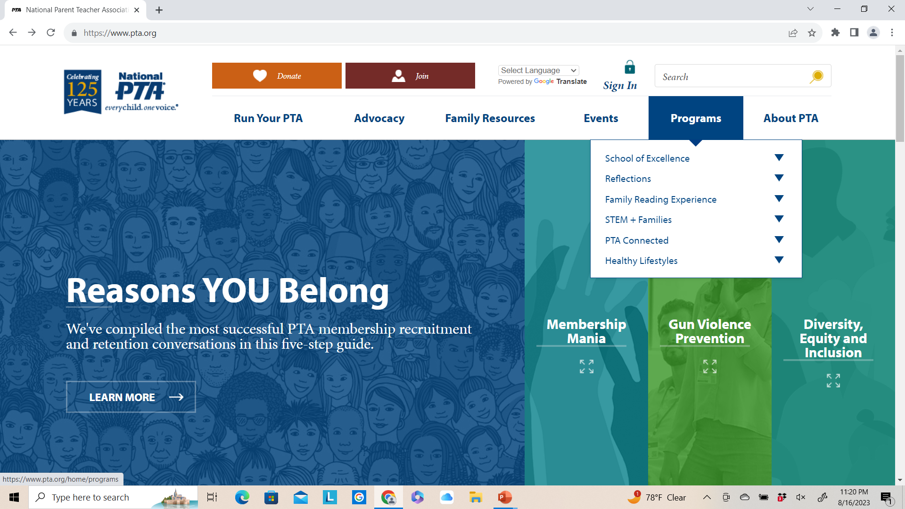
Go to PTA.org
1. Create an account at Sign In
2. Click Programs

Slide 6
National PTA Programs
A School of Excellence designation awards PTA units for building strong partnerships between families and their school that enrich the educational experience and overall well-being for all students. Enrollment is open until October 15 at http://www.pta.org/home/programs/National-PTA-School-of-Excellence
2022-2024 Winners:
Eden Gardens Fundamental Elementary PTA, Shreveport
Fairfield Fundamental Magnet PTA, Shreveport
Mandeville Middle PTA, Mandeville
Marigny Elementary PTA, Mandeville
2021-2023 Winner:
A.C. Steere Elementary PTA, Shreveport

Slide 7
National PTA Programs
Explore the Arts and Express Yourself
Each year, over 300,000 students in Pre-K through Grade 12 create original works of art in response to a student-selected theme. This 50+ year-old program helps them explore their own thoughts, feelings and ideas, develop artistic literacy, increase confidence and find a love for learning that will help them become more successful in school and in life.
Students participate in the appropriate division for their grade:
Primary (Pre-K - Grade 2), Intermediate (Grades 3-5), Middle School (Grades 6-8),
High School (Grades 9-12), Special Artist (All grades welcome).*
Students submit their completed works of art in one or all of the available arts categories: Dance Choreography, Film Production, Literature, Music Composition, Photography, Visual Arts.
To participate, provide reflections contact information (register) with LAPTA at LouisianaPTA.org/reflections and follow the instructions there

Slide 8
National PTA Programs
National PTA is committed to helping families support their child’s development of literacy skills and encourage a love of reading through access to books, particularly those that reflect the diversity of our world.

Slide 9
National PTA Programs
STEM+ Families Programs National PTA's STEM + Families® program delivers access and hands-on exposure to science, technology, engineering and math to engage families and inspire students to pursue career opportunities in STEM fields.
PTA wants to foster passion for science, technology, engineering, and math through fun activities and by involving families in these experiences together. Our STEM initiative will engage students, families, and communities in opportunities to explore... inspire... empower... and educate... STEM possibilities. They are available as in-person and STEM at home activities for Science or Family Engagement Nights.
Programs Where You Are
Local PTAs are encouraged to select PTA Programs and program delivery models based on the unique needs of their school community.
Each program is flexible and offers free technical assistance, leader-to-leader learning opportunities and “drag and drop” materials necessary for success.

Slide 10
National PTA Programs
PTA Connected strives to help children act safely, responsibly, and thoughtfully online, especially with social media. It connects parents with tools, research, and support to make the best decisions for their children. Each Program has its own toolkit with Planning, Promoting, Hosting, and Wrap Up support information.
Be Internet Awesome Event is an interactive night where families engage with one another in meaningful conversations about raising children in an online world.
Digital Families Community Events includes social media and technology use strategies.
The Smart Talk is a free tool that helps caregivers and kids (ages five to 17) have positive, proactive technology conversations and set healthy digital limits together.
Access from AT&T provides low-cost internet service for qualified households.
Build Up and Belong facilitates meaningful technology discussions between teens and their parents and caregivers.

Slide 11
National PTA Programs
Healthy Lifestyles is committed to improving the overall health and well-being of families across the country because we know living a healthy lifestyle is a key component to our students' ability to thrive.
The Healthy Lifestyles initiative offers educational resources and engagement opportunities that empower students and families to make better-informed health decisions.
Healthy Bodies (physical health) includes school meals, school wellness, physical activity, and physical education; PTA hosted Family Fitness nights; physical activity fundraisers and education.
Healthy Minds Program (mental health) was developed to help families make mental health an everyday priority. Check out the resources on this webpage, including informational and activity resources directly for families and resources to help PTAs run PTA Healthy Minds programming.
Healthy Earth (environmental responsibility) can create family engagement opportunities by starting a community compost program or community garden or by educating families and your school administration on how to lessen food waste. Be advocates to make sure environmental considerations are kept front of mind in key decisions such as infrastructure and transportation.

Slide 12
National PTA Programs
Connect 4 Respect works to prevent bullying behavior by creating a positive school climate from the physical building to policies, staff, and peer culture. School climate encompasses everything that contributes to a student's experience with a school—from the physical building to policies, staff and peer culture.
Use the Connect for Respect (C4R) Toolkit to guide your PTA/PTSA in engaging students in improving the school climate and reducing bullying.
Get Started
Assess current school climate
Engage the school community in dialogue
Develop an action plan
Educate and empower students, families, and the community

Slide 13
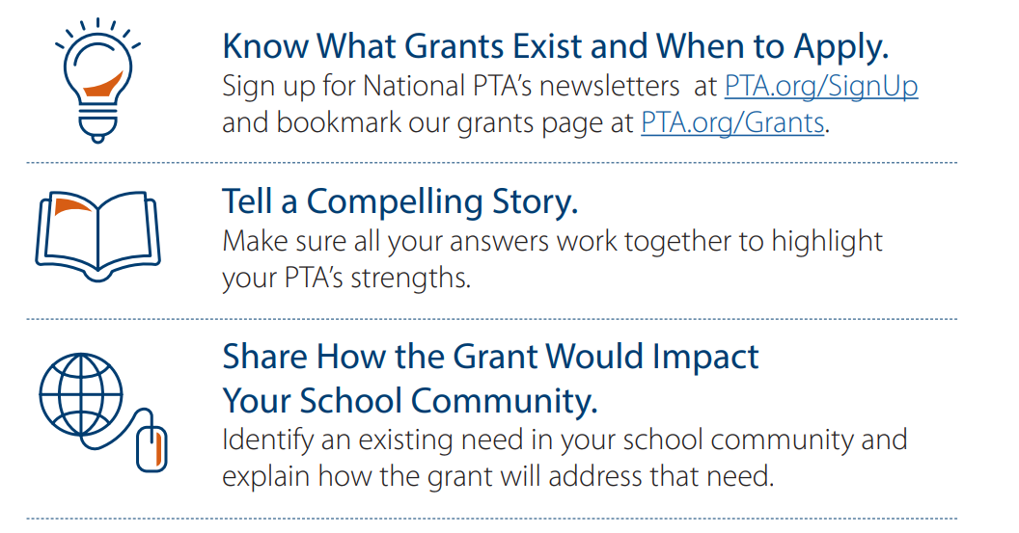
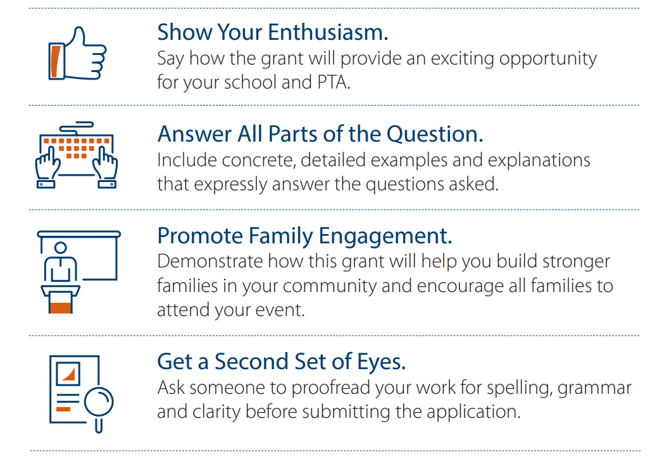
National PTA and Louisiana PTA Program Grants
What are “Grants?”
A grant is a sum of money given by an organization for a particular purpose. National PTA and Louisiana PTA have grants for PTAs and PTA members. There are endless other entities that give money away.
www.pta.org/home/run-your-pta/Awards-Grants
www.LouisianaPTA.org/grants

Slide 14
National PTA Grants
National PTA offers awards or grants to honor or support PTAs as they engage families, support student success, improve the health and safety of students and families, increase access to arts education or celebrate advocacy and diversity.
Go to pta.org/home/programs to explore the programs behind the grants. Which events will excite and educate your PTA community?
Next, go to pta.org/home/run-your-pta/Awards-Grants
Start your application process. You an apply for more than 1 grant!
PTA Grant Deadlines: October 4, 2023 at 4:00 pm CST
Applying for National PTA grants is an easy process and worth your time. $650,000 was awarded in 2022!

Slide 15
National PTA Grants for all grades and ages
PTA Healthy Minds
http://www.pta.org\home\programs\Healthy-Lifestyles\mental-health\for-pta-leaders
100 local PTAs will be selected, and each will be awarded $1,250.
Mary Lou Anderson Reflections Arts Enhancement
http:www.pta.org\home\programs\reflections\artsedtools
Two local PTAs will be selected, and each will be awarded $1,250.
PTA Wellness Fairs
https://www.pta.org\home\programs\Healthy-Lifestyles\pta-wellness-fairs-with-Walmart
40 local PTAs will be selected, and each will be awarded
$1,250 in funding.
4. PTA Connected: The Smart Talk
http://www.pta.org\home\programs\connected\the-smart-talk
40 local PTAs will be selected, and each will be awarded $1,250 in funding. All programs must be completed by the end of March 2024.

Slide 16
National PTA Grants for Elementary Schools
PTA Connected: Ready, Tech, Go!
https://www.pta.org/home/programs/connected/ready-tech-go
150 local PTAs will be selected, and each will be awarded $1,250 in funding. To be considered, PTAs must hold their programs in-person.
STEM + Families Propelling Our World
https://www.pta.org/home/programs/stem/propelling-our-world
30 local PTAs will be selected, and each will be awarded
$1250 in funding.
STEM + Families Science Festival
https://www.pta.org/home/programs/stem/STEM-Families-Bayer-Science-Festivals
40 local PTAs will be selected, and each will be awarded
$1,250 in funding. To be considered, our PTAs must be located
within a 55-mile radius of Luling, LA or St. Charles Parish

Slide 17
National PTA Grants for Elementary or Middle Schools
PTA Connected: Be Internet Awesome
https://www.pta.org/home/programs/connected/be-internet-awesome
50 local PTAs will be selected, and each will be awarded $1,250 in funding.

Slide 18
National PTA Grants for Middle or High Schools
Healthy Bodies Tobacco Prevention Campaign
https://www.pta.org\home\programs\Healthy-Lifestyles\healthy-bodies\tobacco-prevention
At least 15 local PTAs/PTSAs serving grades 6-12 will be selected, and each will be awarded $1,250 in funding.

Slide 19
National PTA Grants for High Schools
PTA Connected: Build Up and Belong
https://www.pta.org/home/programs/connected/build-up-and-belong
25 local PTAs/PTSAs will be selected, and each will be awarded $1,250 in funding.

Slide 20
Louisiana PTA Grants
The $750 Reading and Literacy Grants help PTA Units host literacy events at their schools. Literacy skills in Louisiana are unacceptably low, and LAPTA made literacy opportunities a priority for our children.
For program ideas, reference PTA.org/home/run-your-pta/how-we-pta/access-to-opportunities and PTA.org/home/programs/family-reading
Application Deadline: November 17, 2023
Apply at https://form.jotform.com/221794928286067
Winners Announced: December 1, 2023
Quantity Offered: 4 (One/category)
2022-2023 Grant Winners
The winners of the $750 LAPTA Reading & Literacy Grants were Covington Elementary PTA in Covington and Mandeville High PTSA in Mandeville!

Slide 21
Louisiana PTA Grants
The $750 Healthy Minds Grants encourage PTA Units to host mental health programs. The mental health of all children, parents, and caregivers before, during and after challenges arise is immensely important. Make mental health a priority for your PTA and school.
Contact Jessica Latin, LAPTA Healthy Minds Champion at healthyminds@louisianapta.org for program ideas
Application Deadline: March 27, 2024
Apply at https://form.jotform.com/221748198534162
Winners Announced: May 1, 2024
Quantity Offered: 4 (One/category)
2022-2023 Grant Winners
The winners of the $750 Healthy Minds Grants were the Judson Warriors PTA, Shreveport, and Lake Harbor Middle School PTA, Mandeville!

Slide 22
Louisiana PTA Grants
The $500 Day of Service Grants encourage PTA Units to reach beyond the school and into the community to make a difference. Where is there a need? Who needs the PTA? February 17 is the National PTA Founders’ Day - how can you continue the legacy of PTA?
Application Deadline: March 1, 2024
Apply at https://form.jotform.com/232048704031142
Winners Announced: April 20, 2024
Quantity Offered: 4 (One/category)
2022-2023 Grant Winner
The winner of the $500 Day of Service Grant was
Roseland Montessori PTA in Roseland, LA!

Slide 23
Louisiana PTA Grants
The $500 Creative Teacher Grants support creative, innovative, and fun programs or projects for students. Grants may fund any activity or material which supports student enjoyment, wonder, and engagement. The hope is that this grant will result in fun and enriching projects or opportunities for the students that would not otherwise have been possible.
Application Deadline: April 1, 2024
Apply at https://form.jotform.com/221796420623152
Winners Announced: April 20, 2024
Quantity Offered: 2
2022-2023 Grant Winners
The two winners of the $500 Creative Teacher Grants were Creekside Junior High PTA and
Lake Harbor Middle School PTA in St. Tammany!

Slide 24
Louisiana PTA Programs and Contests
See LouisianaPTA.org/contests or LAPTA Toolkit: Awards, Grants, and Contests, Sec 11 for details, sample flyers, and submittal directions.
Kiki’s Red Ribbon Poster Contest
The Louisiana Seymore D’Fair Foundation celebrates their Kiki Red Ribbon Week School Celebration 2023 with the theme “I’m Better Drug-Free.” Winning entries from Local PTA Units are submitted digitally through JotForm. National Celebration Week: October 23-31, 2023
Deadline to submit to LAPTA: October 20, 2023
Quantity Offered: 9 (Three/category)
LAPTA Winners Announced: October 30, 2023

Slide 25
Louisiana PTA Programs and Contests
See LouisianaPTA.org/contests or LAPTA Toolkit: Awards, Grants, and Contests, Sec 11 for details, sample flyers, and submittal directions.
2025-2026 Reflections Theme Search is looking for a future Reflections theme! The final winning entry for National PTA will receive a $100 prize. Students submit their entries directly with LAPTA.
Deadline: November 17, 2023
Students submit directly to LAPTA at
https://form.jotform.com/231396952311153
Winners Announced: November 30, 2023

Slide 26
2023-2024 Reflections Contest
The PTA Reflections program provides students with opportunities for recognition and access to the arts which boosts student confidence. Visual and performing arts naturally align with established Social and Emotional Learning (SEL) goals.
Each year, over 300,000 students in Pre-K through Grade 12 nationwide create original works of art in response to a student-selected theme. Approaching its 55th year, this program helps them explore their own thoughts, feelings, and ideas, develop artistic literacy, increase confidence, and find a love for learning that will help them become more successful in school and in life.
​
The 2023-24 theme is "I Am Hopeful Because..."

Slide 27
LAPTA Reflections Timeline
Register your Reflections Program Manager with LAPTA at https://form.jotform.com/231397127809160
LAPTA accepts entries in all six Arts Categories. Each Local PTA Unit can decide which Arts Categories their students can enter.
Arts Categories: Dance Choreography, Literature, Visual Arts, Film Production, Music Composition, and Photography
Eligible Local PTA Units can submit three (3) entries from each Arts Category per Grade Division to LAPTA for judging at the state level. If your school has more than one Grade Division, you may submit three entries for each of those separate divisions.
Grade Divisions: Primary (Pre-K to Grade 2) Intermediate (Grades 3-5)
Middle School (Grades 6-8) High School (Grades 9-12) Special Artist (All grades)
The Student Entry Portal link will be shared as soon as it is received from National PTA. This is the platform LAPTA use to accept entries. Guidance on how to use the portal will be provided on the LAPTA website.
LOCAL UNIT ENTRY DEADLINE: Monday, January 22, 2024
Local Units must be Actively Affiliated with LAPTA by December 15, 2023 for student entries to be accepted for judging by LAPTA
Go to https://www.louisianapta.org/reflections for more information and forms
Questions about Reflections? Send a note to arts.education@louisianapta.org

Slide 28
louisianapta.org

Slide 29
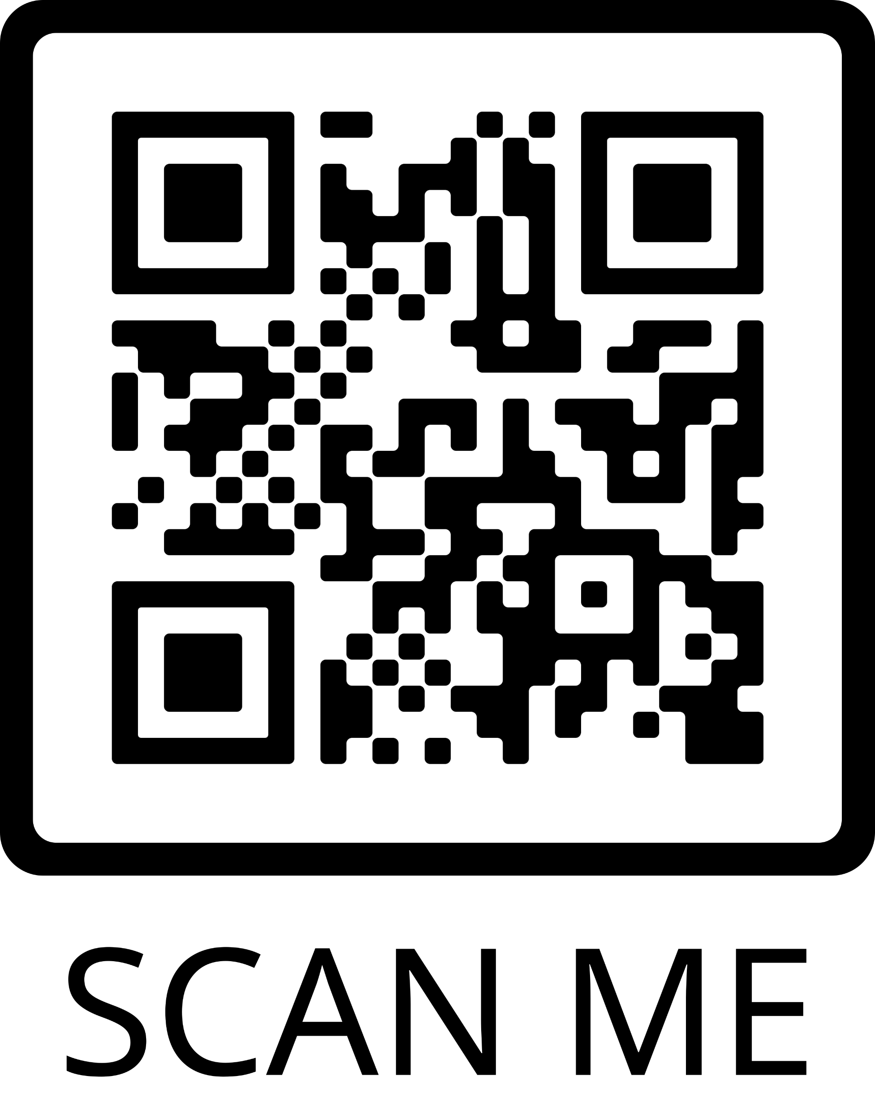
Louisiana PTA is in search of Leaders to serve on the Board of Directors
Apply Here
Email us at
president@louisianapta.org
if you are interested in learning more about volunteering at the State level.

