Slide 1
PTA Development Days
Introduction to Building a More Diverse, Equitable & Inclusive PTA
Workshop
Hosted by Louisiana PTA
LouisianaPTA.org

Slide 2
Why are we here?
Why do you PTA?
To make every child’s potential a reality
by engaging and empowering families and communities to advocate for all children.

Slide 3
PTA
V
A
L
U
E
S
Collaboration: We will work in partnership with a wide array of individuals and organizations to broaden and enhance our ability to serve and advocate for all children and families.
Commitment: We are dedicated to children’s educational success, health, and well-being through strong family and community engagement, while remaining accountable to the principles upon which our association was founded.
Respect: We value the individual contributions of members, employees, volunteers, and partners as we work collaboratively to achieve our association’s goals.
Diversity: We acknowledge the potential of everyone without regard, including but not limited to: age, culture, economic status, educational background, ethnicity, gender, geographic location, legal status, marital status, mental ability, national origin, organizational position, parental status, physical ability, political philosophy, race, religion, sexual orientation, and work experience.
Accountability: All members, employees, volunteers, and partners have a shared responsibility to align their efforts toward the achievement of our association’s strategic initiatives.
This Photo by Unknown Author is licensed under CC BY-SA

Slide 4
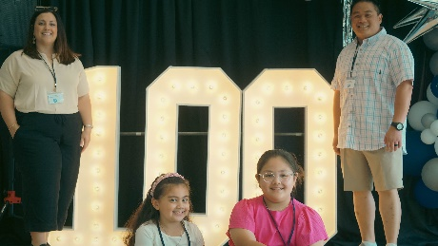
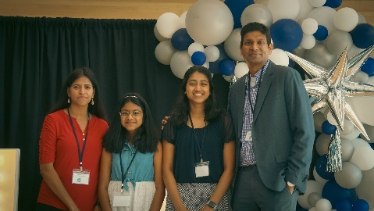
BENEFITS OF ENGAGING ALL FAMILIES
Children whose parents are involved in school are more successful in school
Authentically advocate for the needs of all children
More voices * More hands!

Slide 5
OUR OBJECTIVES:
1
Define concepts of diversity, inclusion, and equity; apply to your local PTA
2
Analyze the diversity, level of inclusion and equity in membership, governance, programs & advocacy in PTA
3
Discover strategies to increase diversity, inclusion and equity in PTA

Slide 6
1
Define concepts of diversity, inclusion, and equity; apply to your local PTA

Slide 7
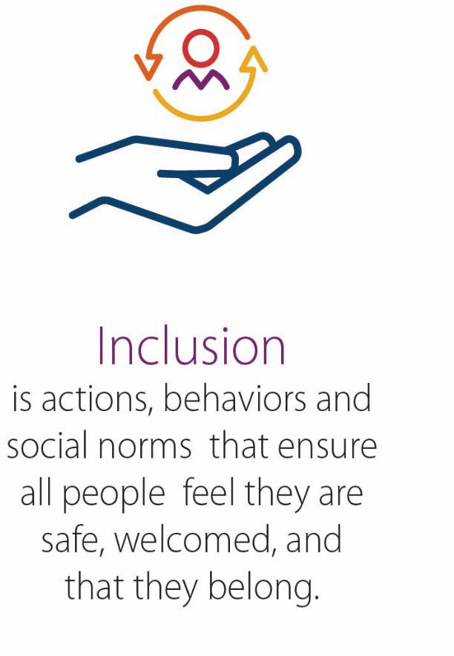
WHAT DO THESE TERMS MEAN?

Slide 8
WE BELIEVE DIVERSITY IS OUR STRENGTH.
We represent parents, caregivers, educators and communities of all children, which enables us to best achieve PTA’s mission to make every child’s potential a reality. Our collective backgrounds, perspectives and ideas allow us to best reflect the rich fabric of 21st century children, families, educators and community members—and create the strongest future and direction for PTA.
What is one way diversity shows up in PTA?

Slide 9
WE BELIEVE COLLABORATION MUST BE INCLUSIVE.
We can only achieve our mission and vision in full collaboration and partnership with the broadest possible set of volunteers, staff, educators, schools and communities. We foster an association where everyone feels they belong, are integral to achieving our vision and have the opportunity to flourish and contribute at the highest level. That means tending to power dynamics where they occur and setting up a level playing field for all to engage in our work.
What is one way inclusion shows up in PTA?

Slide 10
WE BELIEVE EQUITY DRIVES OUR MISSION.
Equity provides fairness in resources, opportunities and outcomes so that all communities get what they need to be engaged and successful. This moves beyond an “equal across the board” approach to:
Recognize and address bias and privilege.
Understand and attend to specific individual and community needs, providing additional resources to those with greater needs.
What is one way equity shows up in PTA?

Slide 11
2
Analyze where your PTA is on its diversity, equity, and inclusion journey

Slide 12
The DEI Journey at PTA
Color/Identity-Blind
Diversity
At the Beginning stage, PTAs are “color-blind,” or “identity-blind,” either by design or default and do not lift up issues of diversity, inclusion, and equity in any regular or routine way.
Inclusion
At the Emerging stage, PTAs are focused on recruitment and building membership and leadership comprised of individuals from different backgrounds and experiences.
Equity
At the Intermediate stage, PTAs are focused on culture and creating an environment in which everyone is comfortable sharing and contributing their experiences.
At the Advanced stage, PTAs are focused on systems to improve equity. The primary goal is integration of an equity lens into all aspects of the association’s work.

Slide 13
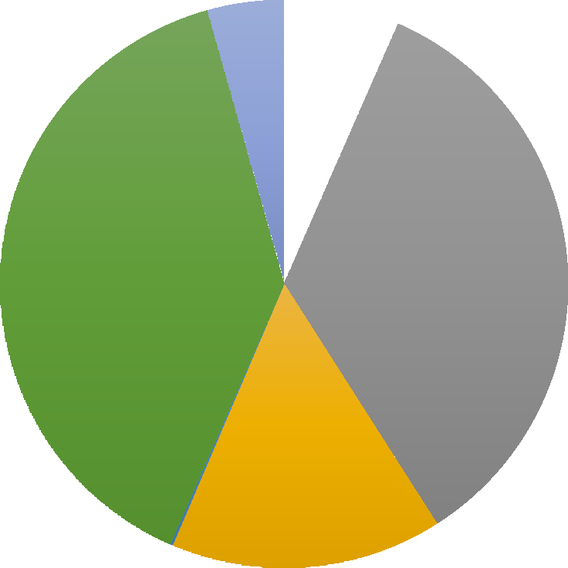
KNOW YOUR SCHOOL AND PTA DATA
Two or more races
4%
Have a clear understanding of your school’s demographic makeup
Asian 6%
Highly Qualified Teachers
Absenteeism
Academic Achievement
Students Receiving Services
Suspensions & Expulsions
Graduation
What else?
White 39%
Black/African Amer.
35%
Hispanic/Latino 16%

Slide 14
KNOW YOUR COMMUNITY
English language learners
Immigrants
Reflect: Which demographics and communities are under- represented in your PTA’s membership and leadership?
Essential workers
Non- Christians
High school students
African- Americans
Military families
LGBTQ
students & families
Students in special education
Homeless students
Magnet program
Grand- parents

Slide 15
IDENTIFY BARRIERS IN YOUR COMMUNITY
Culture
Expectations of parents’ role
Feeling welcome
Attitude towards school & institutions
Language
Socio-economics
Costs (real or assumed)
Availability
Other priorities
Institutional programs, policies, practices
Meeting format
Activities & meeting topics
Relevancy of advocacy issues
Related to academic success of students
Relevant to parents’ concerns & priorities
Accessible advocacy activities

Slide 16
3
Discover strategies to move to more equity- centered membership, leadership, programs & advocacy

Slide 17
EQUITY IN PTA MEMBERSHIP

Slide 18
EQUITABLE MEMBERSHIP
General Approach:
Have little to no engagement with parents/community members who do not actively seek out organization
Assuming everyone knows
what PTA is about
Not collecting or analyzing data by demographic group
With a More EQUITABLE Lens:
Asking every parent to join the PTSA
Partnering with community
organizations to reach out to potential members
Sharing messages that conveys
that every parent belongs in PTA
Membership sponsorships

Slide 19
CREATE EFFECTIVE PTA MESSAGING
Why PTA exists – what are the goals, what do you stand for
What your PTA has achieved
How parents’ engagement with PTA benefits themselves, their children and the school community
Address issues that matter most to the families and communities whom you seek to engage
What your PTA expects of members – dues, volunteering, advocacy, meetings

Slide 21
EQUITY IN PTA GOVERNANCE & LEADERSHIP

Slide 22
EQUITABLE GOVERNANCE & LEADERSHIP
General Approach:
Rotation of the same PTA leaders
Nomination Committee asks
people they know to run for office
Plan a couple activities focused
on diversity
With a More EQUITABLE Lens:
Diversity committee helps every committee use a “DEI lens” in their workplans
Measure your progress on DEI
efforts – both in headcounts and in impacts
Review bylaws for leadership
requirements that may limit diversity in leadership

Slide 23
How would you refine or revolutionize PTA’s governance structures to advance diversity, equity, and inclusion?
OVERCOMING STRUCTURAL BARRIERS

Slide 24
EQUITY IN PTA PROGRAMMING

Slide 25
EQUITABLE PROGRAMS
GENERAL Approach:
Program Committee hosts the same program(s) annually
Family Reading Night
Program Topic: Tips for Beach Week!
With a More EQUITABLE Lens:
Family Reading Night with active parent participation, ELL supports, activities to take home, and feedback opportunities
Program Topics:
College Application Prep
Summer Employment Options
Keep programs relevant to families’ needs

Slide 26
EQUITY IN PTA ADVOCACY

Slide 27
EQUITABLE ADVOCACY
General Approach:
Everyone gets school supplies
Posting a #BlackLivesMatter image on social media
With a More EQUITABLE Lens:
Advocating for history/social studies content that covers indigenous experiences
Discussing disproportionate discipline with school leaders
Advocating for more diverse teachers and employees in school
Coaching a parent on how to advocate for her child to receive their special education services

Slide 28
What is one thing you will start, stop, or change to advance diversity, equity and inclusion in your PTA?
YOUR COMMITMENT

Slide 29
Learn More!
PTA Leader Resource: National PTA DEI Resource Guide, June 2023
How to Welcome Diverse Perspectives into Your PTA (en Español)
PTA Leader Training: PTA 101: The National Congress of Colored Parents and Teachers and Unification
Parent Resource: How to Talk to Your Child About Race and Injustice in America
Parent Resource: Notes from the Backpack: A PTA Podcast
National PTA’s Commitment to Diversity, Equity, and Inclusion (en Español)
National PTA’s Position Statement on Institutional Racism

Slide 30
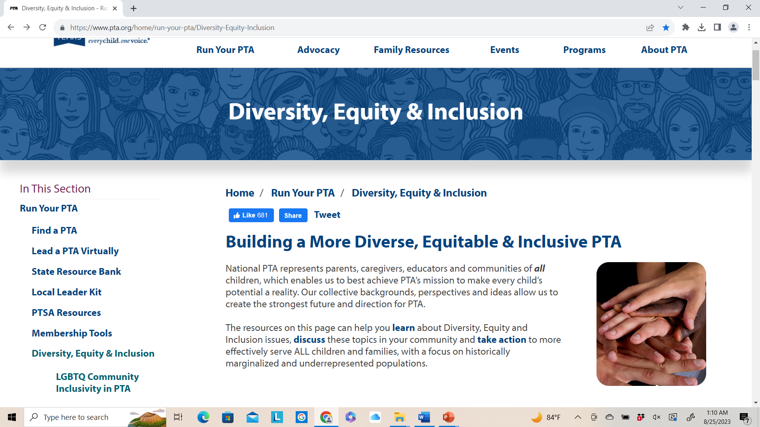
pta.org/home/run-your-pta/Diversity-Equity-Inclusion

Slide 31
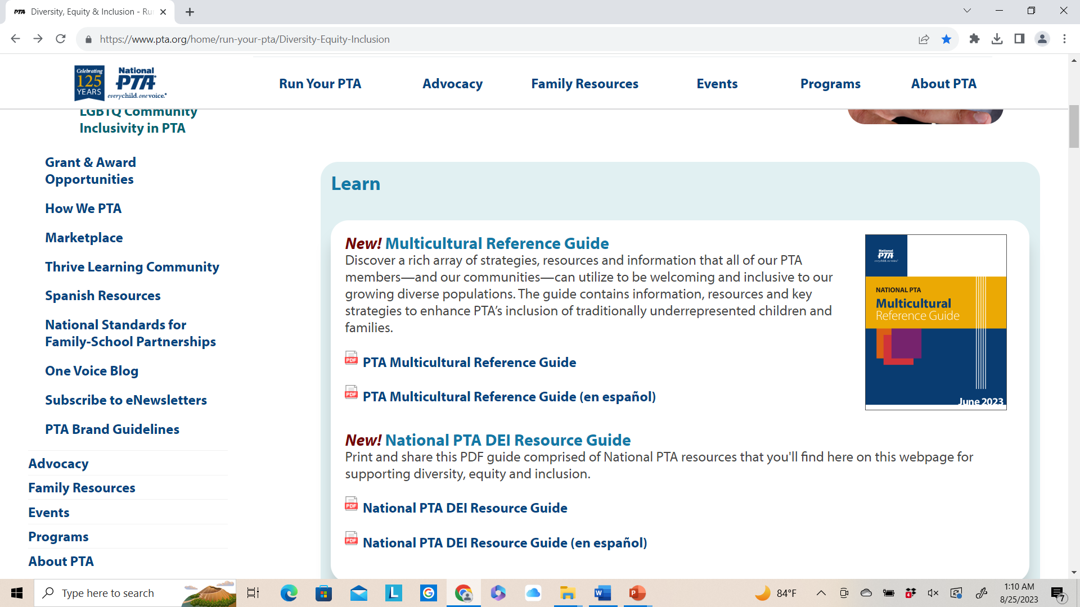
pta.org/home/run-your-pta/Diversity-Equity-Inclusion

Slide 32
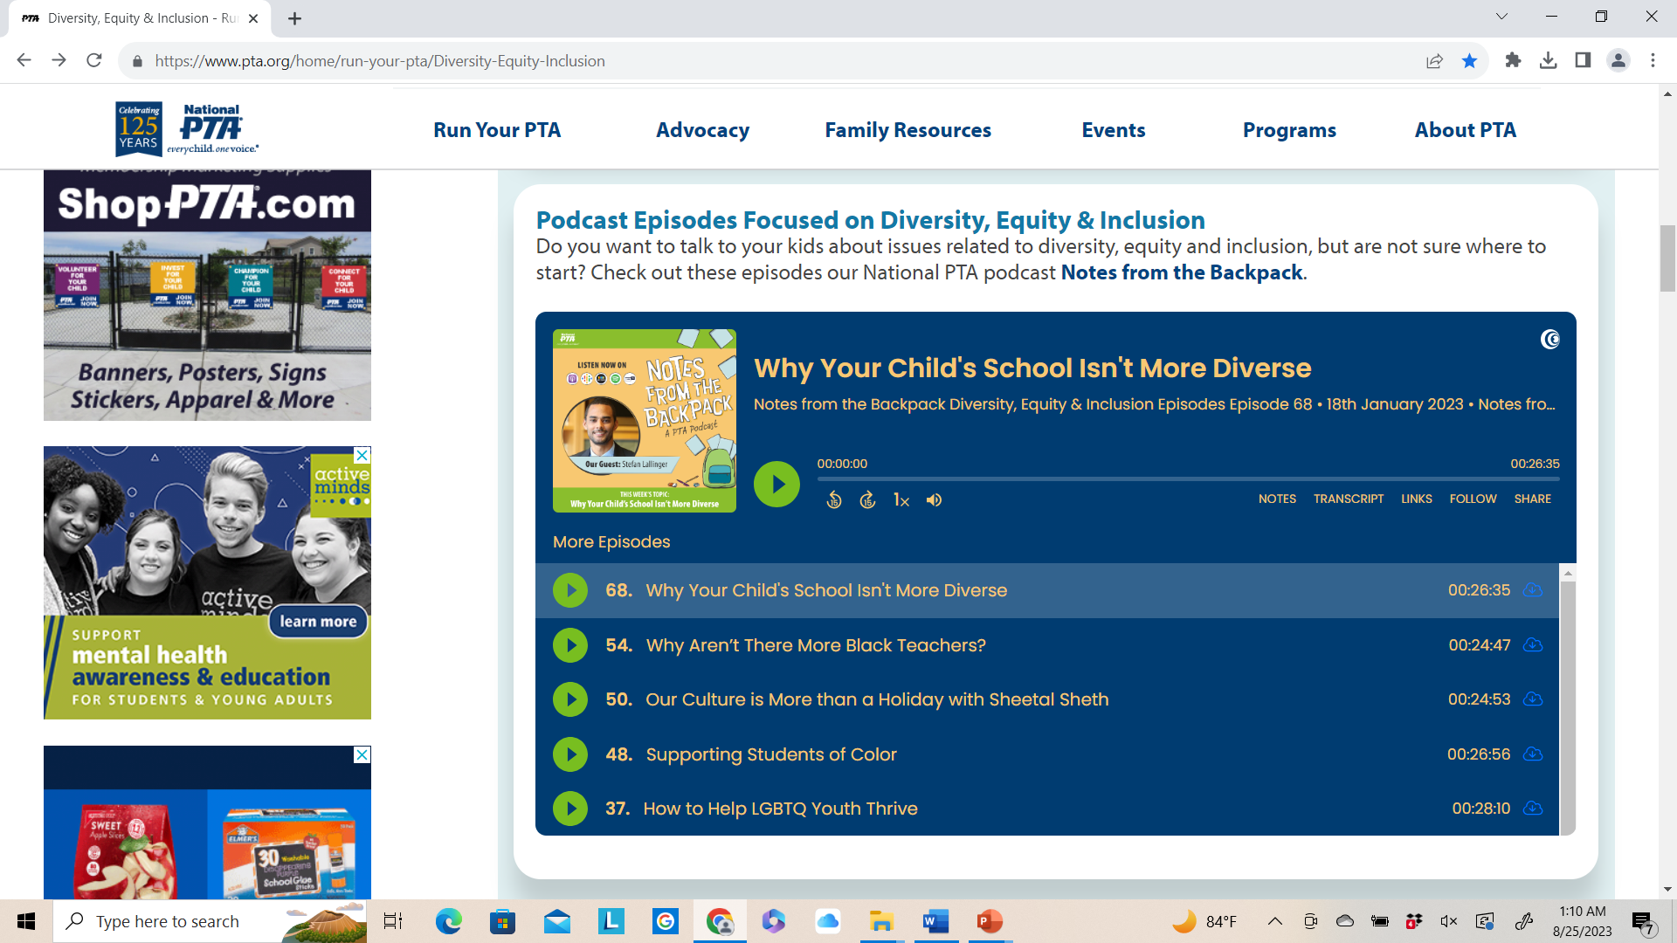
pta.org/home/run-your-pta/Diversity-Equity-Inclusion

Slide 33
Resources from the
Diversity, Inclusion, & Outreach Committee
A community for resource-sharing, encouragement, and problem- solving!
National PTA Diversity, Inclusion, and Outreach Facebook Group
Questions for the Committee?
E-mail diversity@pta.org
Have something special to share about your DEI work or want to see some good examples?
Check out and apply for the Jan Harp Domene Diversity & Inclusion Awards

Slide 34
louisianapta.org/dei

Slide 35
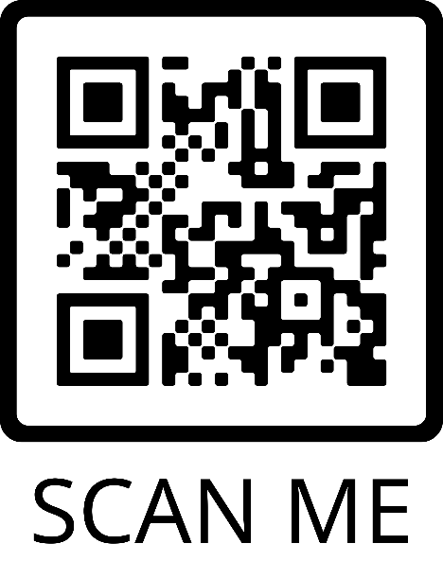
Louisiana PTA is in search of Leaders to serve on the Board of Directors
Apply Here
Email us at
president@louisianapta.org
if you are interested in learning more about volunteering at the State level.

