Slide 1

PTA Development Days
Engaging Families of Students who are Differently-Abled and Neurodivergent in PTA
Workshop
Hosted by Doris Heckert, LAPTA Chair Special Populations Committee
special.populations@louisianapta.org

Slide 2
Why are we here?
Why do you PTA?
To make every child’s potential a reality
by engaging and empowering families and communities to advocate for all children.

Slide 3

PTA
V
A
L
U
E
S
  Collaboration: We will work in partnership with a wide array of individuals and organizations to broaden and enhance our ability to serve and advocate for all children and families.
  Commitment: We are dedicated to children’s educational success, health, and well-being through strong family and community engagement, while remaining accountable to the principles upon which our association was founded.
  Respect: We value the individual contributions of members, employees, volunteers, and partners as we work collaboratively to achieve our association’s goals.
  Diversity: We acknowledge the potential of everyone without regard, including but not limited to: age, culture, economic status, educational background, ethnicity, gender, geographic location, legal status, marital status, mental ability, national origin, organizational position, parental status, physical ability, political philosophy, race, religion, sexual orientation, and work experience.
  Accountability: All members, employees, volunteers, and partners have a shared responsibility to align their efforts toward the achievement of our association’s strategic initiatives.
This Photo by Unknown Author is licensed under CC BY-SA

Slide 4

Building an Inclusive Parent Teacher Association
Notes:
“She can't get inside the building because of her wheelchair."
No. She can't get inside because the building is not accessible. The building has a barrier that does not let her in. The wheelchair is not the problem; the building's lack of access is the problem.”
14 % of all students in the US have been identified as having a disability
6% of public school students are enrolled in gifted and talented programs
The National Association for Gifted Students estimates 6% of US students receiving special education services are also academically gifted (2E)
.

Slide 5
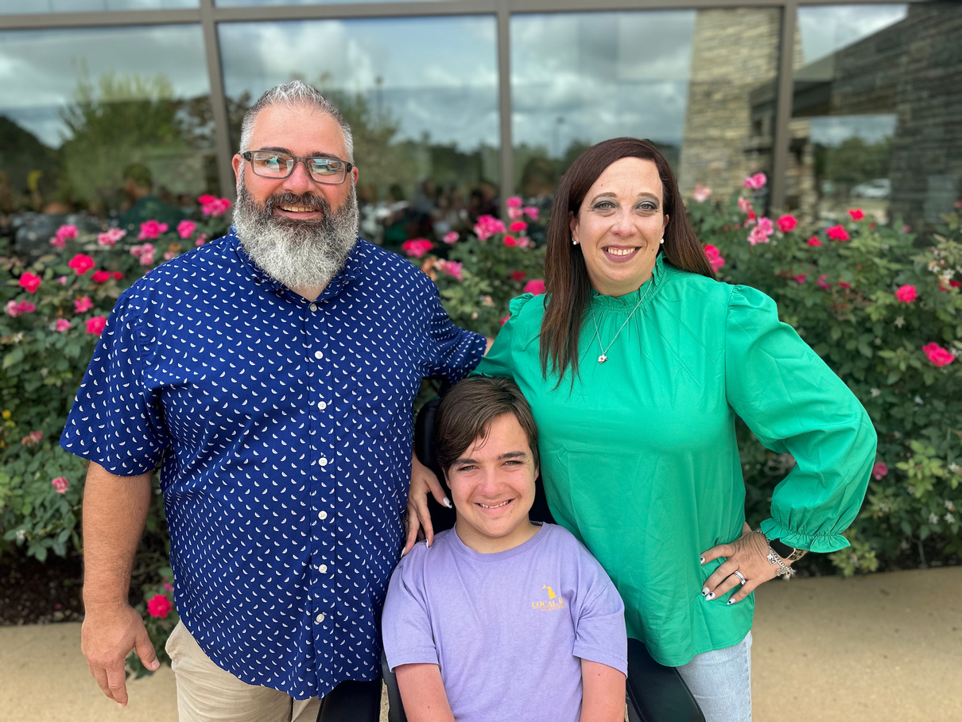
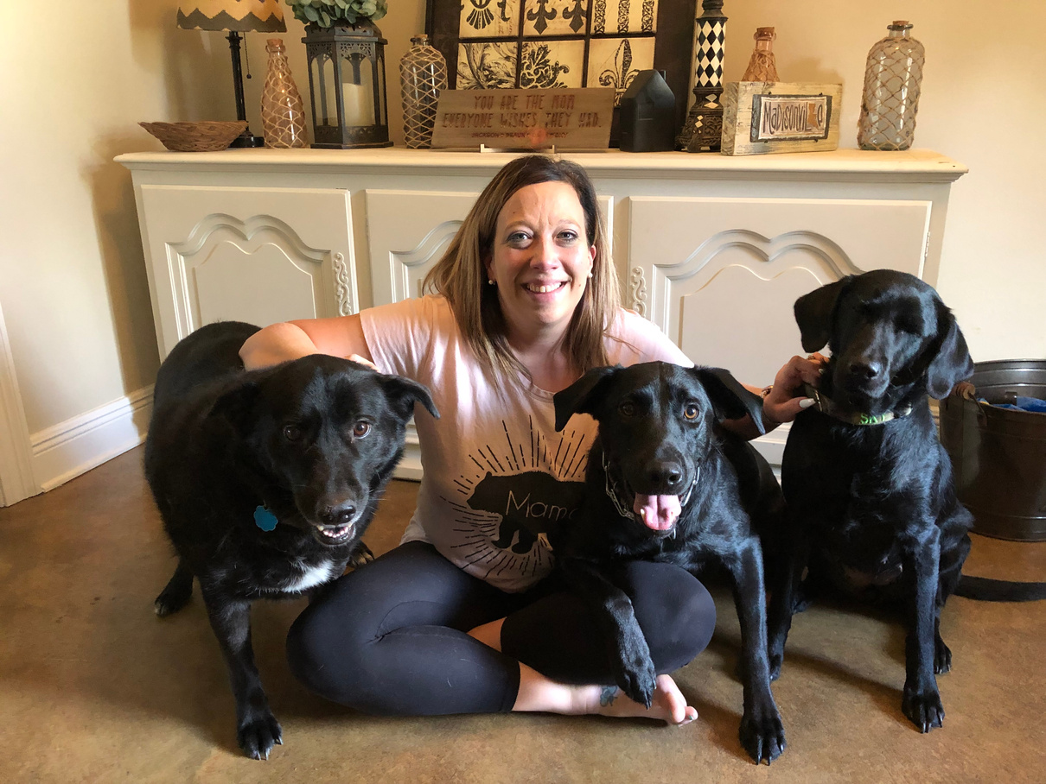
<number>
This Photo by Unknown Author is licensed under CC BY-SA
Notes:
Behind everyone of these numbers are families – people and faces just like yours and mine – we crave connection to schools and communities and family engagement. We want to be a part of the conversation and to help create a more inclusive world.

Slide 6

Introduction to the Standards
The National Standards for Family-School Partnerships provide a framework for building effective relationships between families and schools.
Notes:
The national standards for Family-School Partnerships provide the framework for local PTAs to build effective relationships with families that include students who receive Special Education services including gifted and talented.

Slide 7

Standard 1: Welcoming all families into the school community
Schools must provide a welcoming environment for all families.
Families should be treated as partners in their child's education.
Schools must provide clear and effective communication with families.
Notes:
In order to welcome all families, we must be aware of barriers for families with students who are differently-abled. Being aware of barriers can be a huge starting point.
-Barriers
*parking
*sidewalks
*stage (Photo Booth)
*eating - having space set up
-UNIVERSAL DESIGN-
Treating families as partners in their child’s education means creating opportunities for all students.
-Create opportunities for connection
-open house/back to school nights/curriculum nights/etc.
Providing clear and effective communication with families must include families of all students. Think of parents who may also be deaf, etc.

Slide 8

Standard 2: Communicating effectively
Provide regular and accessible communication between school and families.
Use culturally responsive methods to effectively communicate with diverse families.
Create opportunities for two-way communication and feedback between families and school staff.
Notes:
Communication between families and school should be regular and effective.
*ask
-there are no “stupid” questions when they come from a place of seeking understanding
-seek out families who want to be spokespeople
-understand where families are coming from
-post-event round tables
*what worked/what didn’t

Slide 9

Standard 3: Supporting student success
Establish a positive and respectful relationship between families and educators.
Provide families with frequent and meaningful communication about their child's academic and social-emotional development.
Collaborate with families to support student learning and success.
Notes:
Families want their students to succeed…while that looks different for each child…we all want our children to be successful.
Ways to establish positive and respectful relationships include:
-expand efforts to not just to inform - but hear from and respond to families
Communicating with families frequently is important. Be sure to reach families in a variety of ways.
- Collaborate with all families plan for the future
*provide outside resources/guidance for families to support social, emotional, academic learning

Slide 10

Standard 4: Speaking up for every child
Encourage all families to advocate for their children.
Provide resources and support for families who may face barriers to advocacy.
Collaborate with families to develop and implement strategies to support their child's success.
Notes:
Encourage families to be a voice for their children – it’s not always easy to be the one who speaks up. Be an encourager who comes alongside families.
STORY HOW WE AREN”T MADE TO FEEL LIKE WE ARE ASKING FOR SOMETHING HE DOESN”T DESERVE.
-Connect families with resources
*LAPTA - my role
-teach them to “fish”

Slide 11

Standard 5: Sharing power
Build trusting relationships between families, educators, and community members.
Recognize and respect the diverse cultures, experiences, and perspectives of families.
Involve families in decision-making processes that affect their children's education.
Notes:
Building relationships with families is a cornerstone of sharing power.
-transparency and access in decision making builds trusting relationships among stakeholders
-support development of PTA that represents all families
-give families and students voices about decisions that affect them – their lived experiences should be recognized and respected

Slide 12

Standard 6: Collaborating with community.
Establish partnerships with community organizations.
Engage families and community members in decision-making processes.
Develop programs and initiatives that help families and schools work together more effectively.
Notes:
-link with community resources
*build parent to parent networks
*fire drills – stair chair – students with sensory issues
-engage all members of community in the decision making process
- partner with school planning
- including curriculum
-build staff’s cultural competence through advocacy, trainings, etc.

Slide 13
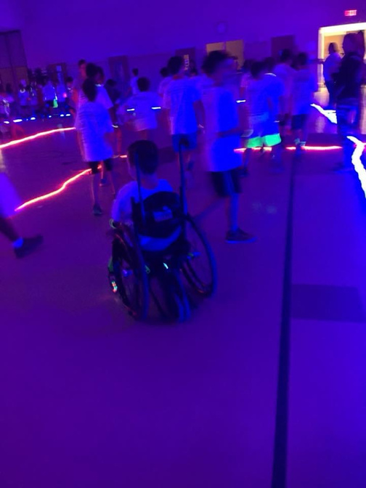
Inclusion is an approach not a program!
Notes:
It is not inclusion if you invite people into a space you are unwilling to change.

Slide 14

https://www.louisianapta.org/toolkits

Slide 15


Louisiana PTA is in search of Leaders to serve on the Board of Directors
Apply Here
Email us at
president@louisianapta.org
if you are interested in learning more about volunteering at the State level.

