Slide 1
PTA Leadership Training Advocacy
Hosted by Louisiana PTA
LouisianaPTA.org
advocacy@LouisianaPTA.org

Slide 2
Why are we here? Why do you PTA?
To make every child’s potential a reality
by engaging and empowering families and communities
to advocate for all children.

Slide 3
What is Advocacy?
In the context of PTA, advocacy is supporting and speaking up for children – in schools, communities, and before government bodies and other organizations that make decisions affecting children.
louisianapta.org/advocate

Slide 4
Who are PTA Advocates?
PTA advocates speak up for every child to ensure a high‐quality public education, no matter the race, ethnicity, disability, gender, income or place of birth.​
PTA advocates engage families in schools, communities and all
levels of government to protect the rights of all children and families.​
YOU!​
You are a PTA Advocate.​

Slide 5
Purpose of National PTA
To promote the welfare of children
To raise the standards of home life
To speak up for laws that further the education, physical and mental health, welfare and safety of children
To engage the public in united efforts to secure the physical, mental emotional, spiritual, and social sell-being of children.
LouisianaPTA.org/advocate
LouisianaPTA.org/advocate

Slide 6
National PTA Values
Collaborate with a wide array of individuals and organizations
Committed to children's educational success and health
Acknowledging diversity and the potential of everyone without any regard
Respect and value individual contributions of members, employees, volunteers and partners while working collaboratively to achieve PTA goals
LouisianaPTA.org/advocate

Slide 7
National PTA Standards for Family-School Partnerships
Welcoming All Families into the school Community
Communicating Effectively
Supporting Student Success
Speaking Up for Every Child
Sharing Power
Collaborating with the Community
This Photo by Unknown author is licensed under CC BY-NC.
LouisianaPTA.org/advocate

Slide 8
Did you know...
The most basic level of Advocacy is simply working to making things better.
Speaking to someone of power to better a need is Advocacy.
Raising funds to support a change is Advocacy.
Talking to your childs Teacher about a problem and working with them to form a solution is Advocacy.
LouisianaPTA.org/advocate

Slide 9
Advocacy facts
PTA was founded by Advocates – people who worked towards bettering the lives of every child in education, health and safety
We have a strong history of impacting education policy and advocating for children. Advocacy is required to achieve success for all children.
There are many ways to achieve social change, and all have their uses.
PTA and its members utilize different forms of social change in our overall advocacy efforts.
LouisianaPTA.org/advocate

Slide 10
PTA Advocacy:​
Organizing & Amplifying Voices​
Legislative Advocacy
Grassroots Advocacy
Self-Advocacy

Slide 11
National PTA Framework:​ Legislative Advocacy
National PTA is a 501(c)(3) nonprofit and leads federal advocacy work.​
National PTA’s annual public policy agenda guides federal advocacy​.
National PTA does not take positions for or against state‐level policies.​
State and Local PTAs are encouraged to align with National PTA’s positions.
State and Local PTAs may not contradict national resolutions or position statements​.
Key legislation: PTA.org/home/advocacy/federal-legislation/Key-legislation

Slide 12
Hill Day 2022

Slide 13
2022 Hill Day Asks
Youth Mental Health: Because all children deserve strong mental health support and services!
Child Nutrition Reauthorization: Because all children deserve quality, nutritious school meals!
Community Safety and Youth Violence Prevention: Because all children should feel safe and welcome in their school community!
FY2022 Reconciliation and FY2023 Appropriations: PTA has long advocated to ensure children have access to adequately funded public schools that improve their overall well-being and allow students to reach their fullest potential.
LouisianaPTA.org/advocate

Slide 14
Forms of Organizing for Social Change:​
Form​ | Approach​
Service​ | Providing a direct response or program to solve a problem​
Education​ | Researching and raise awareness a problem to generate support for an issue​
Speaking Up for Others​ | Lobbying about an issue on behalf of a community​
Grassroots​ | Engaging the people directly affected by the problem to take action and win a solution​
LouisianaPTA.org/advocate

Slide 15
PTA and Grassroots
PTA's Advocacy Training focuses on grassroots advocacy. Our resources include content and materials that will help any Local Unit build its advocacy capacity.
LouisianaPTA.org/advocate

Slide 16
Louisiana PTA resources allow leaders to...
Create a cadre of parents that are ready, willing and able to advocate on policy issues.
Demonstrate PTA's influence with key stakeholders by PTA becoming a go-to resource for decision making.
Strengthen systems and processes to support high-impact advocacy initiatives.
Go to Lousianapta.org/advocate to download LAPTA Toolkit Section 7, Advocacy.
LouisianaPTA.org/advocate

Slide 17
Louisiana PTA Mission Partners
Louisiana Partnership for Children and Families
Mission: The Partnership unites voices in Louisiana to improve the well-being of children through public policy advocacy, communications and the promotion of evidence-based programming.
Voter Voice
Mission: The Partnership unites voices to improve the well-being of children through public policy advocacy, communications and the promotion of evidence-based programming.

Slide 18
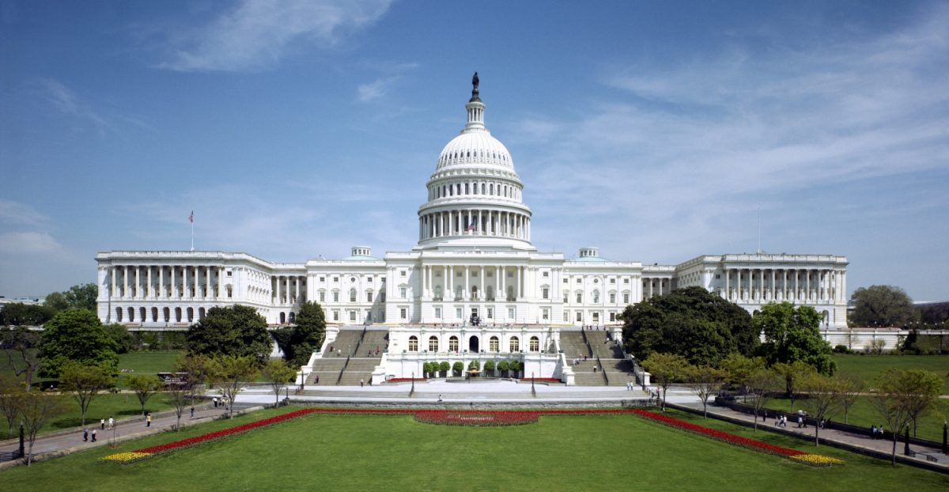
Federal Legislative Chair (FLC)
Louisiana PTA put in place a Federal Legislative Chair (FLC) in 2022.
The FLC is a key link between National PTA, state PTA members, and LAPTA leadership to promote advocacy and awareness of PTA’s federal public policy agenda and legislative issues. An FLC has a year-round responsibility and commitment. By promoting these priorities year-round, FLCs serve as the leader in the state to embed advocacy in everything they do.
LouisianaPTA.org/advocate

Slide 19
Federal Legislative Chair (FLC)
Duties (not limited to):
Participate in and promote National PTA action alerts
Maintain regular contact with our federal legislators
Encourage all Board members, PTA members, and your communities to sign up for PTA Takes Action Network and e-newsletter.
Keep state membership and leaders up to date on key federal legislative priorities and issues.
Promote advocacy in our state on National PTA public policy positions.
Attend annual Legislative Conference in Washington, DC.
Attend National PTA Convention and bring resolutions back to Members, Leaders and Community regarding our Children's Well-being on Federal level.
LouisianaPTA.org/advocate

Slide 20
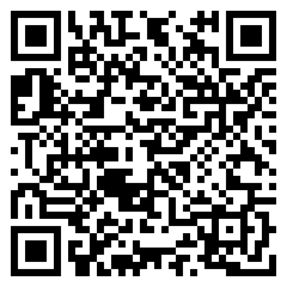
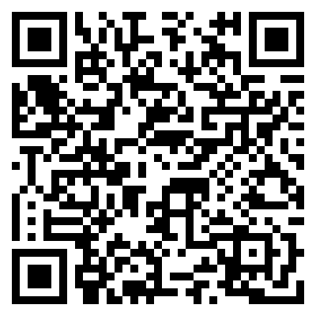
LAPTA Advocacy Awards
1. Advocates for Children Award for PTA Units:
Local PTAs can apply for the Outstanding Advocates for Children (OAC) or Be the Voice (BTV) advocacy awards. See the application for requirements and categories of advocacy work. Winners are announced on March 25 at the Centennial Celebration in Baton Rouge.
2. Advocates for Children Award for Students:
Student Advocacy Award recognizes students who help to truly enhance public education. Students who are involved with civic engagement at an early age are the pillars of Louisiana’s future! Students can apply online for the Outstanding Advocates for Children (OAC) or Be the Voice (BTV) advocacy awards.
LouisianaPTA.org/advocate

Slide 21
Questions and Answers
What are some issues you would like to be addressed?
Have you noticed any situations that you feel strongly about but don’t know how to help?
Is there an ongoing problem you would like to get resources to prevent?
What are some areas you would like to see LAPTA assist?
LouisianaPTA.org/advocate

Slide 22
Kaionnia Scott VP Advocacy Louisiana PTA advocacy@louisianapta.org

